Slide 1
Fintech project proposal
Done by:
Lever, Charles
Mohan, Aadil
Tracy, David
Vu, Minh Chau
Seshadri, Krishnaprasad

Slide 2
Current problems
Issues in splitting the household bills while sharing room with different housemates.
Need to maintain a separate track of all the bills either using notebook or electronically.
Entrust somebody with being the custodian of your money.
Not sure how the money is spent. One must keep tracking it and keep doing reconciliation on user end to be sure that our money is not being spent without our consent.

Slide 3
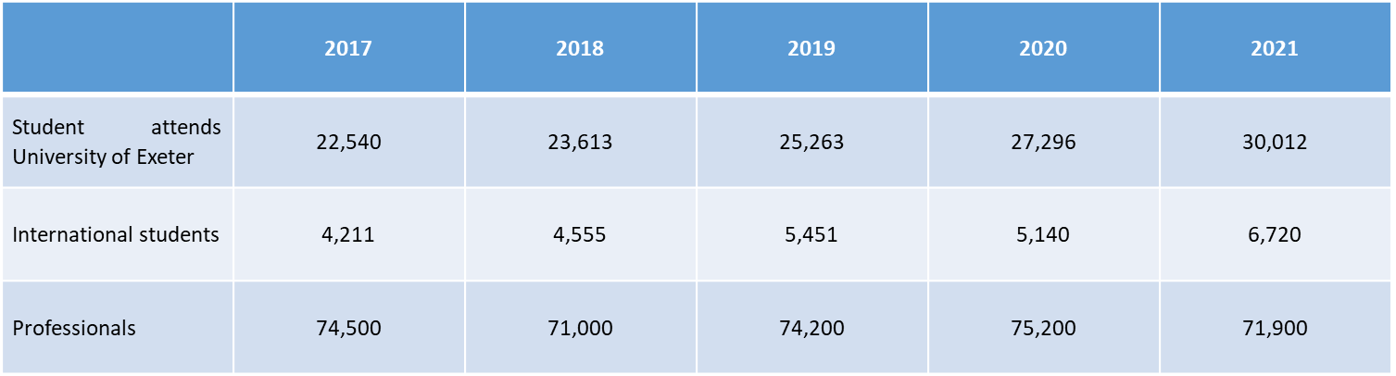
Target market
The app is heavily focused on students and working professionals.
With the amount of students increasing every years, and with 182 properties (according to home.co.uk) available at the present, it is safe to assume that many people will have to share an accommodation, and thus having the need sharing the bill for utilities. While some properties included the utilities bill into the rent, others don’t, and this is where our application comes in.
Tables x. Number of student and working professional in Exeter from 2017 to 2021 (source: University of Exeter, National Online Manpower Information System)

Slide 4
Anticipated Process
The app is designed around a selection of Bitcoin SV wallets, with each tenant in a house having one, and an overarching household wallet where outgoing payments will be made
Payment process:
When a bill is soon due, each tenant user will be able to transfer a proportional amount of BSV from their wallet to the household wallet
Once the household wallet detects each payment is received and balance is equal to the incoming bill, the outgoing transaction is authorised
Transactions out of the household wallet move to an exchange wallet where BSV is exchanged for the relevant accepted fiat currency
In exchange for the outgoing payment, the household wallet will generate receipts for each tenant user with all relevant information deposited into their account within the app

Slide 5
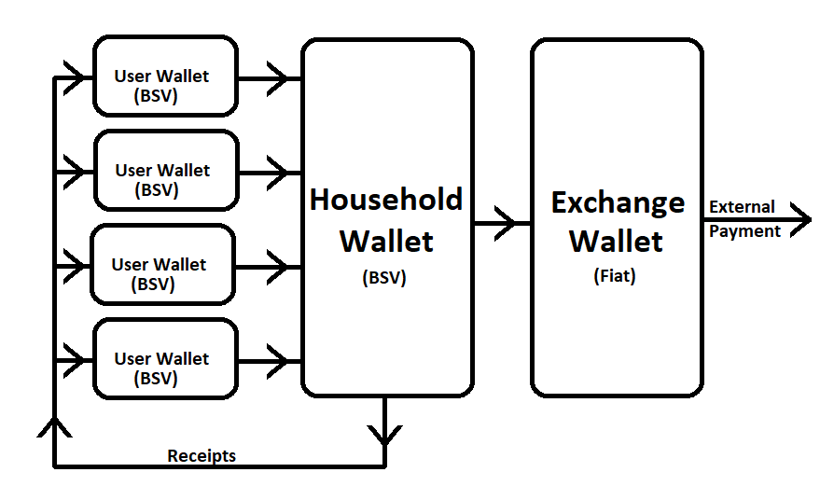
Anticipated Process- Diagram

Slide 6
Consumer Benefits
Convenience
Consolidates household bills received.
Funds may be automatically deducted on pre-determined dates or manually paid.
Receipt of payment is sent for ease of tracking expenses.
Accountability
Automatically distributes “payment due” so individuals are not reliant on another person.
Method of bill allocation is setup on pre-determined methods such as square feet or strict percentage breakout.
Users are notified when others have paid or when due date is close.
Shared view of joint wallet and status of payments.

Slide 7
Profitability
There are several ways to profit from the app as the demographic varies in different regions.
First, we can take a percentage cut on the transactions if our user count is low. The costs for the user would be low as the transaction charges in BSV is low.
Second, we can make it as a subscription model if our user count is high and add extra features in a “pro” model.
Third, we can take a one-time payment and offer all features to everyone.

